Slide 1
Introduction to the Hydrologic Cycle
Today’s agenda
Why do we care about groundwater?
Hydrologic cycle
Water balance

Slide 2
So what?

Slide 3
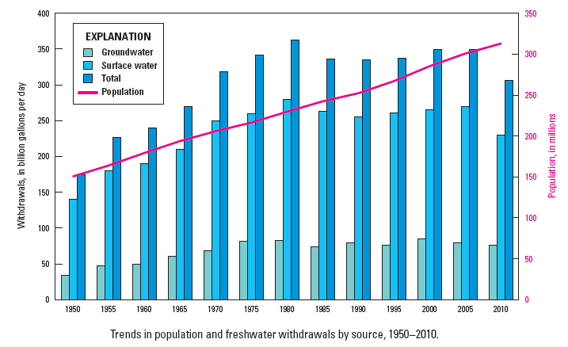
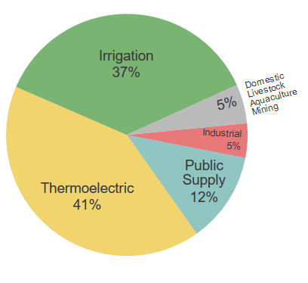
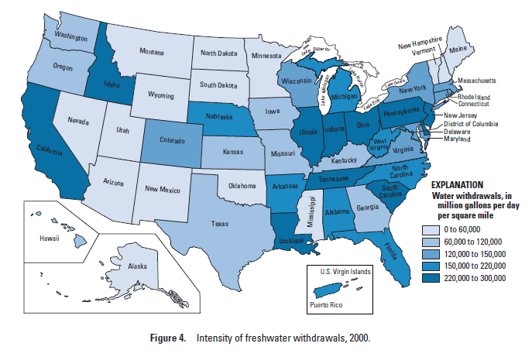
How much are we using?
Water In the U.S.
Source: Hutson et al., Estimated use of water in the United States 2000, USGS Circular 1268, 2004.
How is it being used?
Who is using it?

Slide 4
Water In the U.S.
How much water do we use?

Slide 5
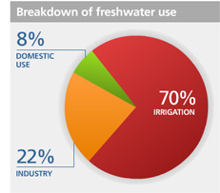
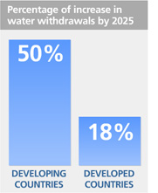
In the World
Domestic Water Use (selected countries) | [Gallons/day]
Canada | 209
U.S. | 176
South Africa | 44
Egypt | 40
Costa Rica | 23
Honduras | 9
Ghana | 9
Mozambique | 3
(37% in US)
(12% in US)
(5% in US)
World Water Use
www.water.org
Per capita water consumption in developed countries is on average about 10 times more than in developing countries
% of Total Use
http://www.unwater.org/statistics_use.html

Slide 6
Water Content of Things
Item | Liters of water
Beverages (per L)
Glass of water | ~1
Bottled water | 3-4
Glass of beer | 300
Produced Goods (per Kg)
Roasted coffee | 21,000
Tea | 9,200
Cotton Textile | 11,000
Microchip | 16,000
Hamburger | 16,000
Crops (per Kg)
Corn | 900
Sugar | 1,500
Assorted animals (per Kg meat)
Goat | 4,000
Beef | 15,000-70,000
Chicken | 3,500-5,700
You:
The human body is ~65% water
Typical consumption is 2-3 liters/day
Note: 1L of water weighs ~1kg
Source: Gleick et al., The World’s Water 2008-2009 The Biennial Report on Freshwater Resources, Island Press, Washington, D.C., 2009.

Slide 7
Relative Merits of Surface and Subsurface Reservoirs
Surface Reservoirs | Subsurface Reservoirs
Disadvantages | Advantages
Few new sites free (in USA) | Many large-capacity sites available
High evaporative loss, even in humid climates | Practically no evaporative loss
Need large areas of land | Need very small areas of land
May fail catastrophically | Practically no danger of failure (structural)
Varying water temperature | Water temperature uniform
Easily polluted | Usually high biological purity, although pollution can occur
Surface Reservoirs | Subsurface Reservoirs
Advantages | Disadvantages
Water may be available by gravity flow | Water must be pumped
Multiple usage (recreation) | Only uses are storage and conveyance
Usually low mineralization of water | Water may be highly mineralized
Maximum flood control value | Minor flood control value
Large flows | Limited flow at any one point
Relatively easy to investigate and manage | Expensive and difficult to investigate and manage
Low maintenance costs | Maintenance of recharge areas or wells must be continuous and is expensive

Slide 8
Hydrology:
Describes and predicts the occurrence, distribution, movement, and chemistry of all water on earth.
Hydrogeology:
The study of groundwater and its interaction with and through the geologic environment.
Geohydrology:
Sometimes a synonym for hydrogeology. Primarily in engineering fields.
Underground Water or Subsurface Water:
All water below the surface of the earth
Groundwater hydrology deals primarily with the water in the saturated zone (groundwater occurs beneath the water table) and in the upper few km
There is also water in the unsaturated zone (soil moisture)
We will discuss both groundwater flow in the saturated and unsaturated zones

Slide 9
Hydrogeologists deal with 2 primary issues: Water Supply Water Quality Supply: - How much water can we extract? (sustainably?) - Where should we pump from to extract the most with the least impact?

Slide 10
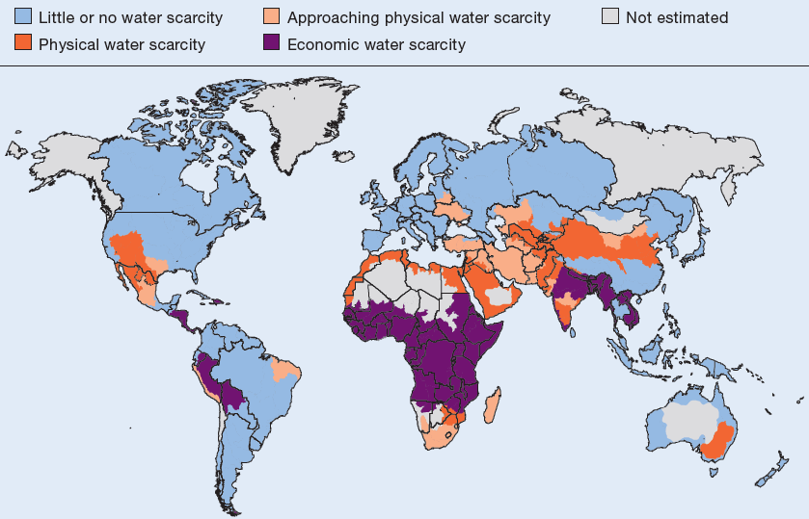
Source:
International Water Management Institute, A Comprehensive Assessment of Water Management in Agriculture, 2007
Problems: Water Supply
Water Quality

Slide 11
Hydrogeologists deal with 2 primary issues: Water Supply Water Quality Supply: - How much water can we extract? (sustainably?) - Where should we pump from to extract the most with the least impact? Quality: - How much and where should we pump in order to ensure good water quality? - Contaminant transport: if there’s a spill, where is it going? How can we clean it up (remediation)?

Slide 12
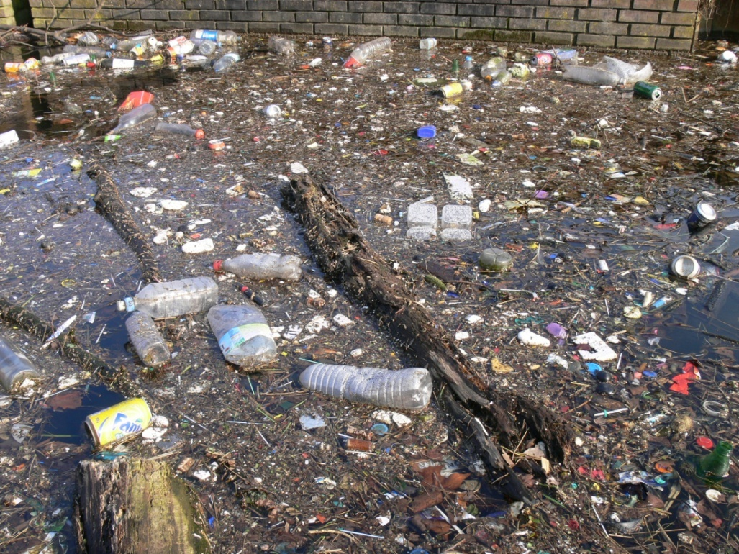
All water bodies are vulnerable to contamination
These include:
Oceans
Estuaries
Lakes
Rivers/streams
Wetlands
Groundwater
Major sources of contamination (mostly anthropogenic):
Municipal
Industrial
Agricultural
Major types of contamination:
Chemicals
Nutrients
Pathogens
Sediment and debris
Temperature

Slide 13
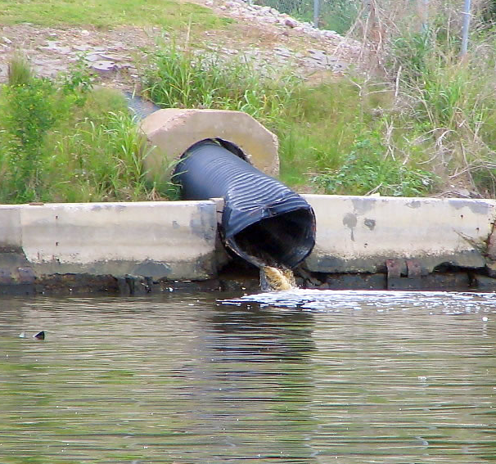
Point-Source Pollution:
Industrial Effluent
Wastewater treatment plants
Oil and chemical spills
Leaky underground storage tanks
Leaky or unlined landfills

Slide 14
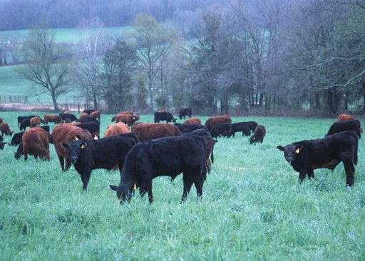
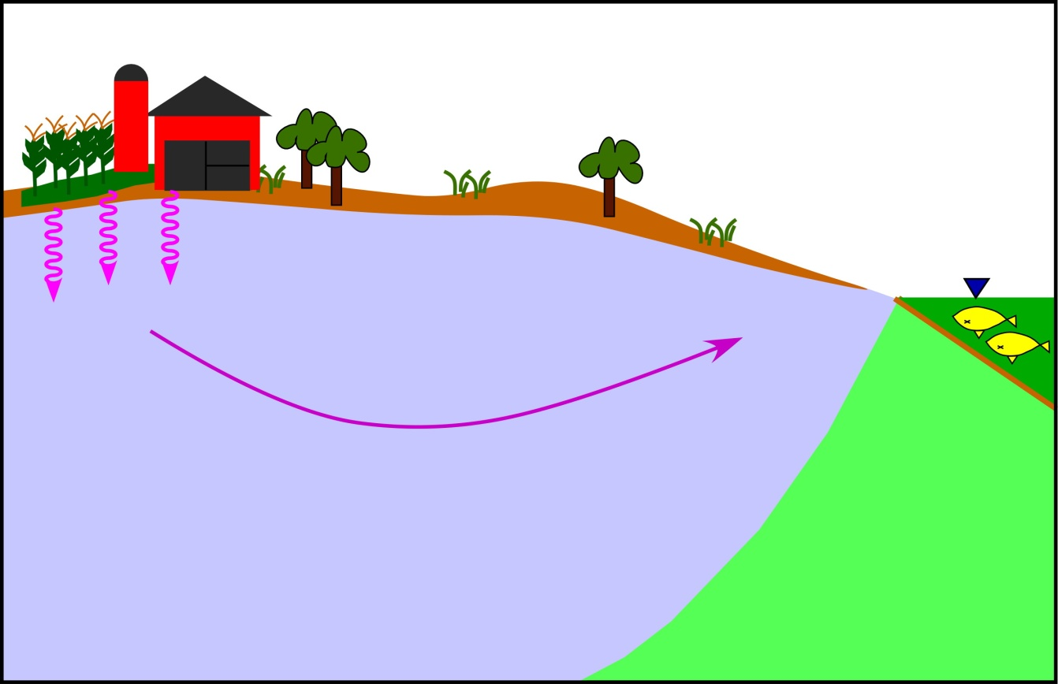
Nonpoint-Source Pollution:
Agriculture: fertilizers, herbicides, insecticides (also lawns)
Urban runoff and energy production: oil, grease, chemicals
Human disturbance: excess sediment
Acid mine drainage
Road salt
Livestock, septic systems:
bacteria and nutrients
Atmospheric deposition

Slide 15
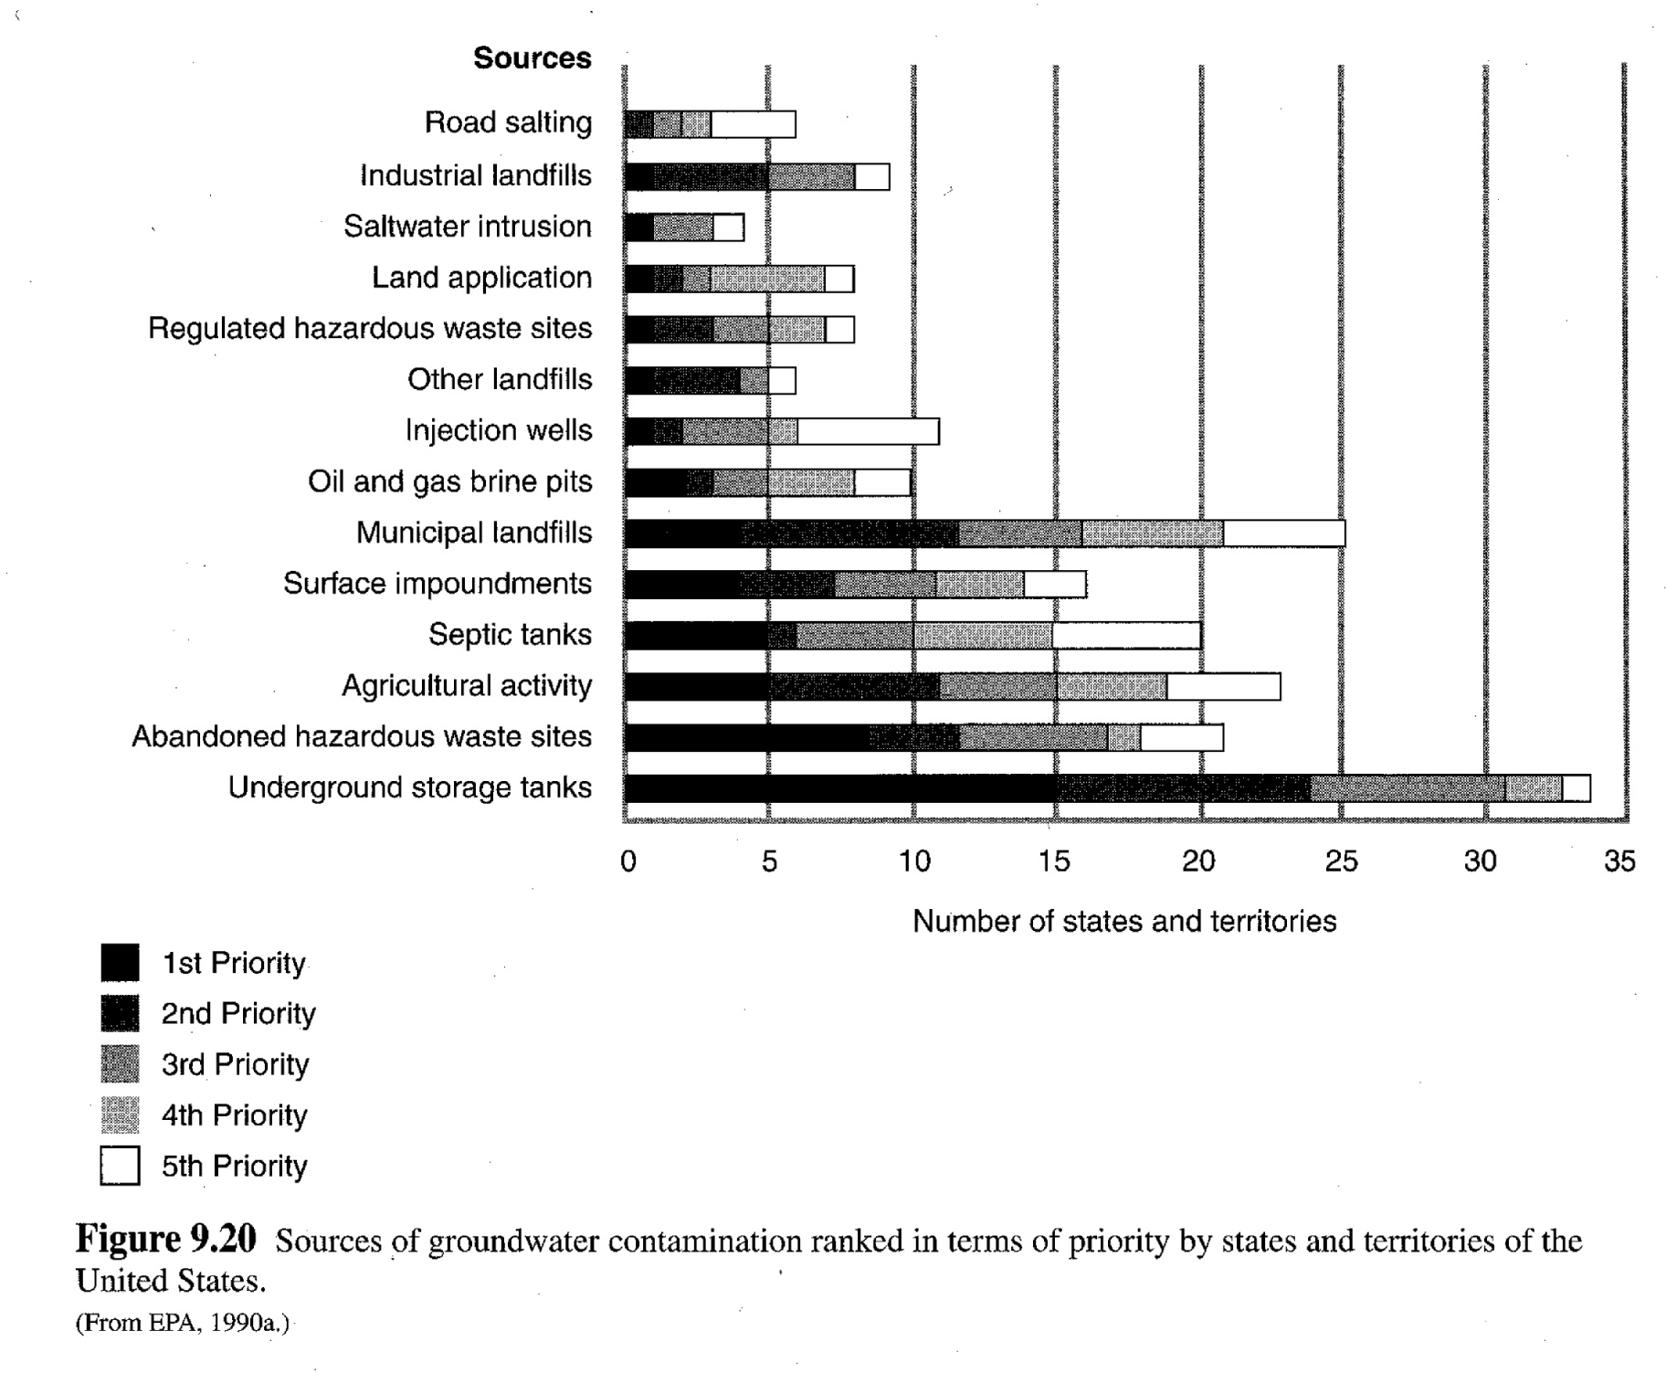
Groundwater Contamination
In the U.S.

Slide 16
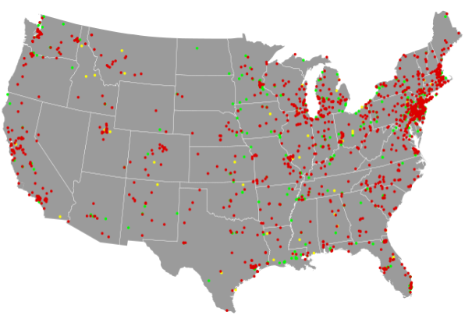
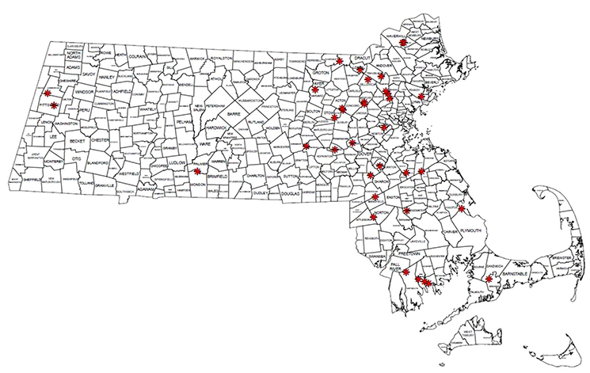
Superfund site locations

Slide 17
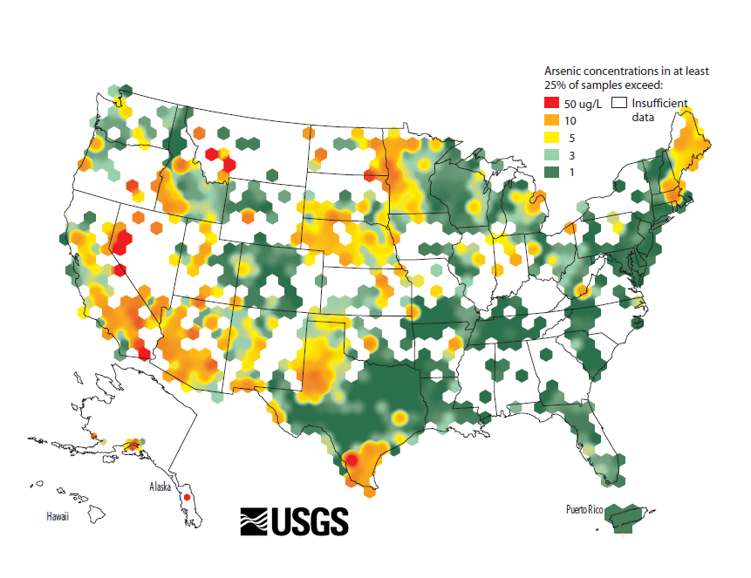
Source: Ryker, S.J., Nov. 2001, Mapping arsenic in groundwater: Geotimes v.46 no.11, p.34-36.

Slide 18
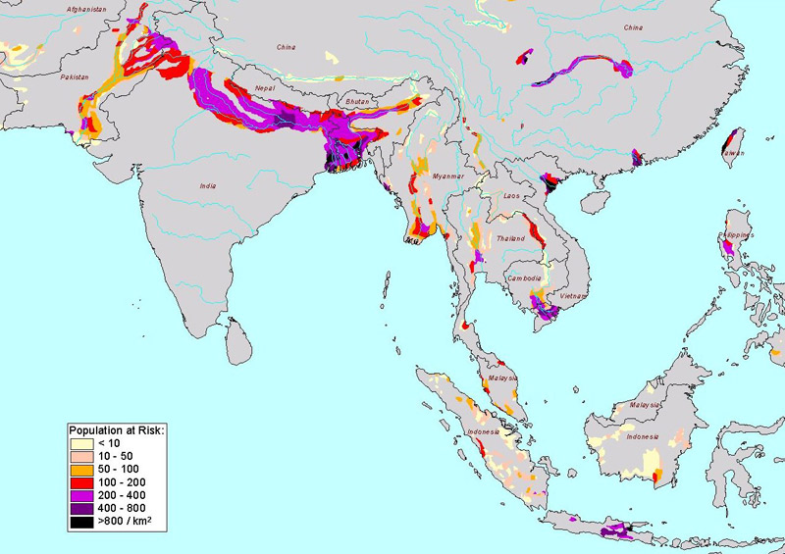
Source: Royal Geographical Society, www.rgs.org

Slide 19
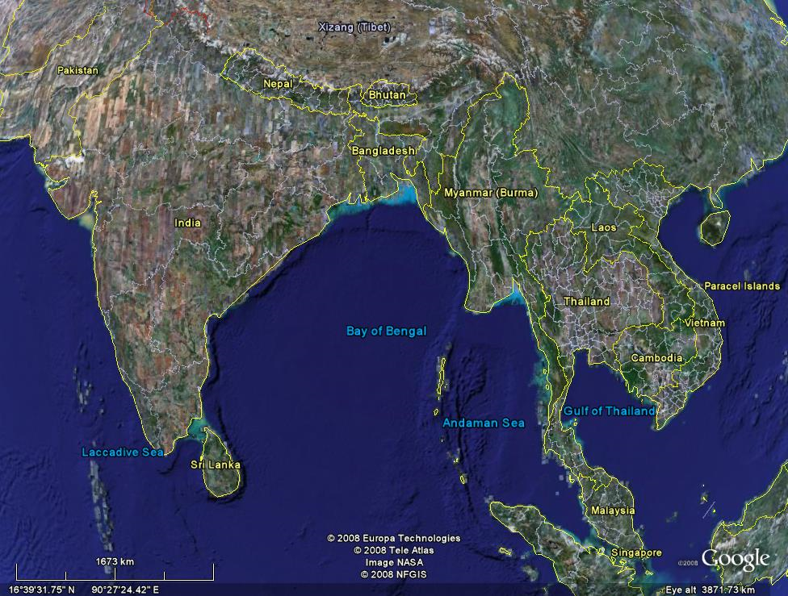

Slide 20
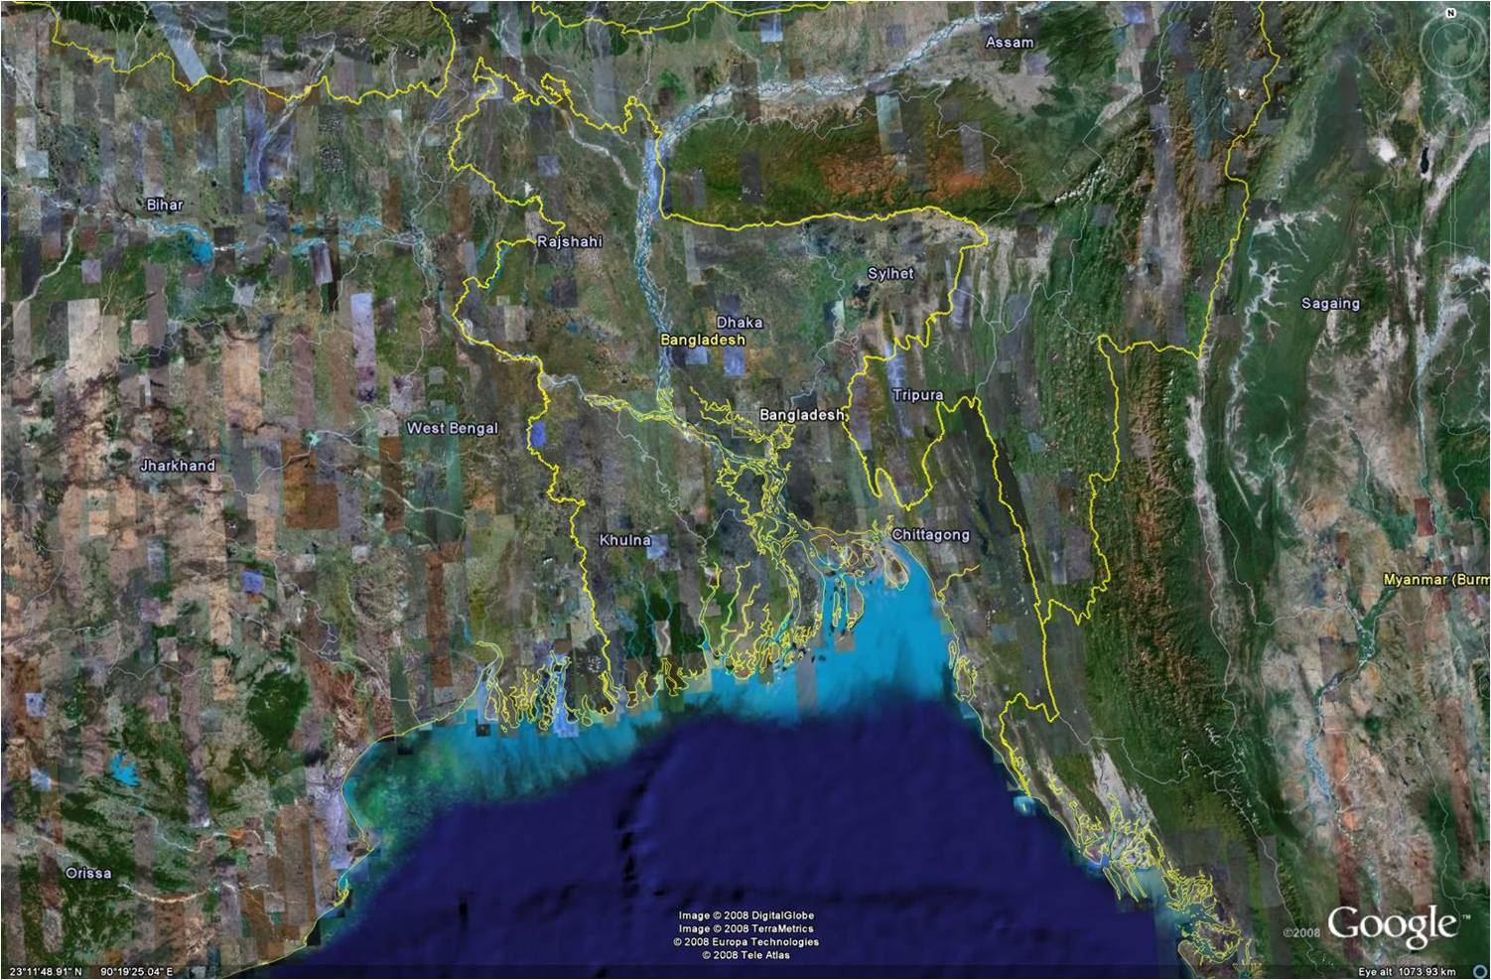

Slide 21
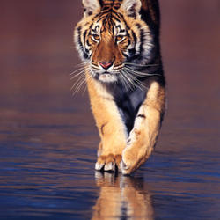
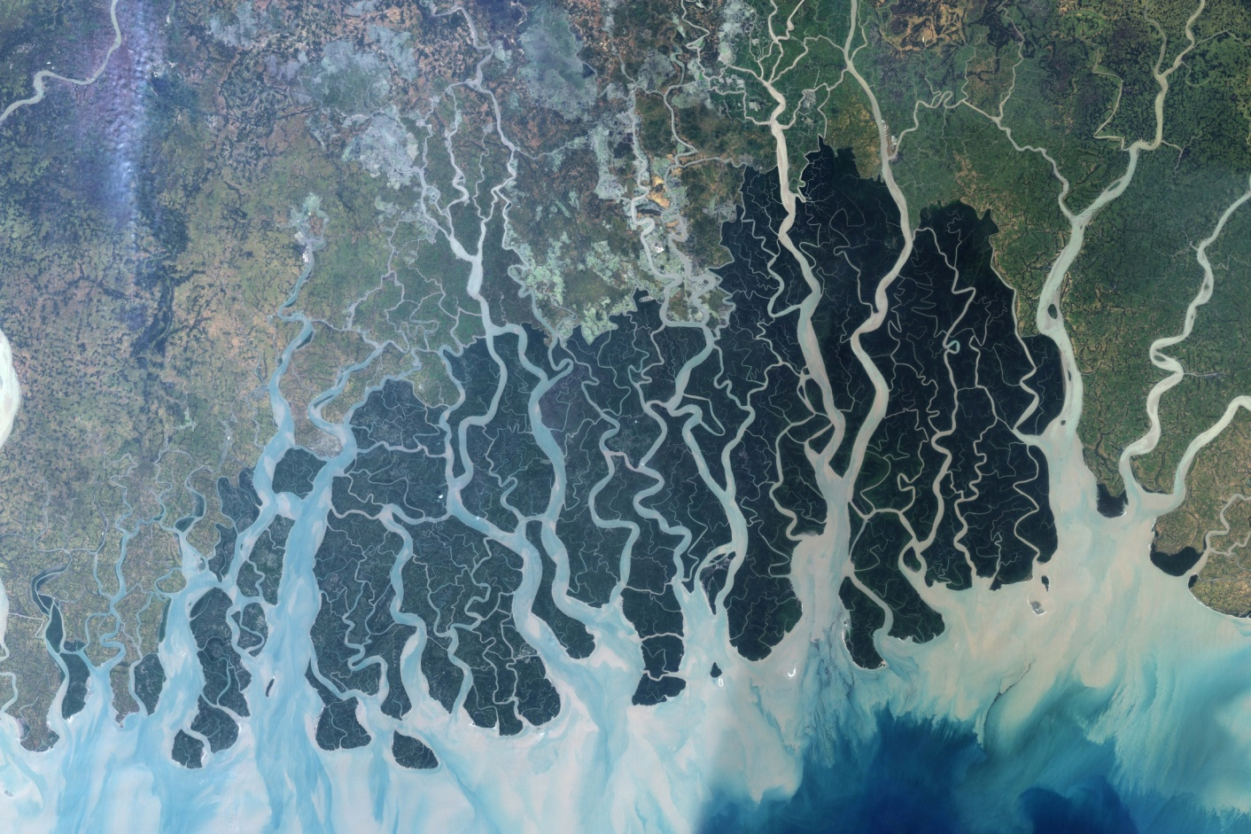
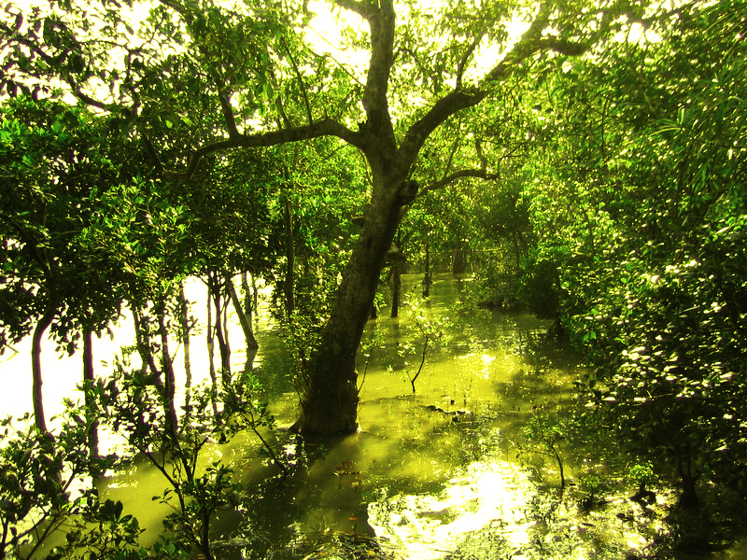
https://www.worldwildlife.org/species/bengal-tiger
https://en.wikipedia.org/wiki/Sundarbans

Slide 22
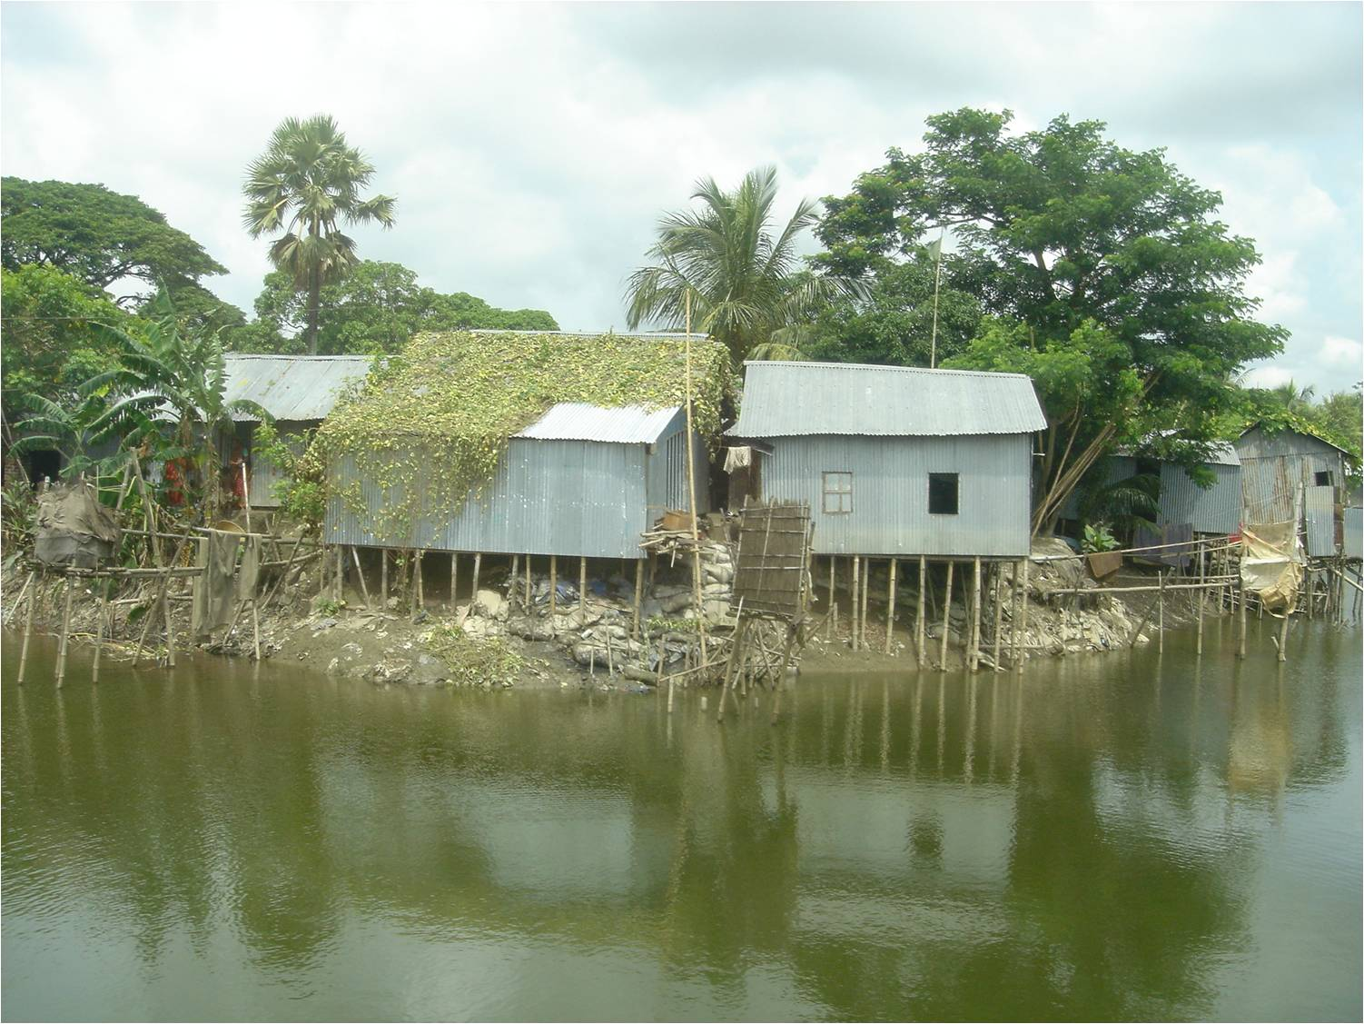

Slide 23
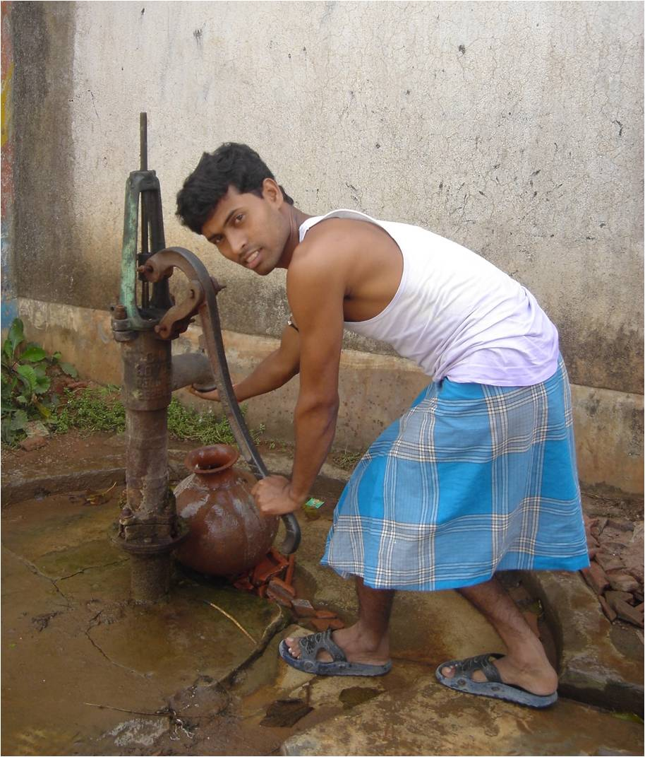
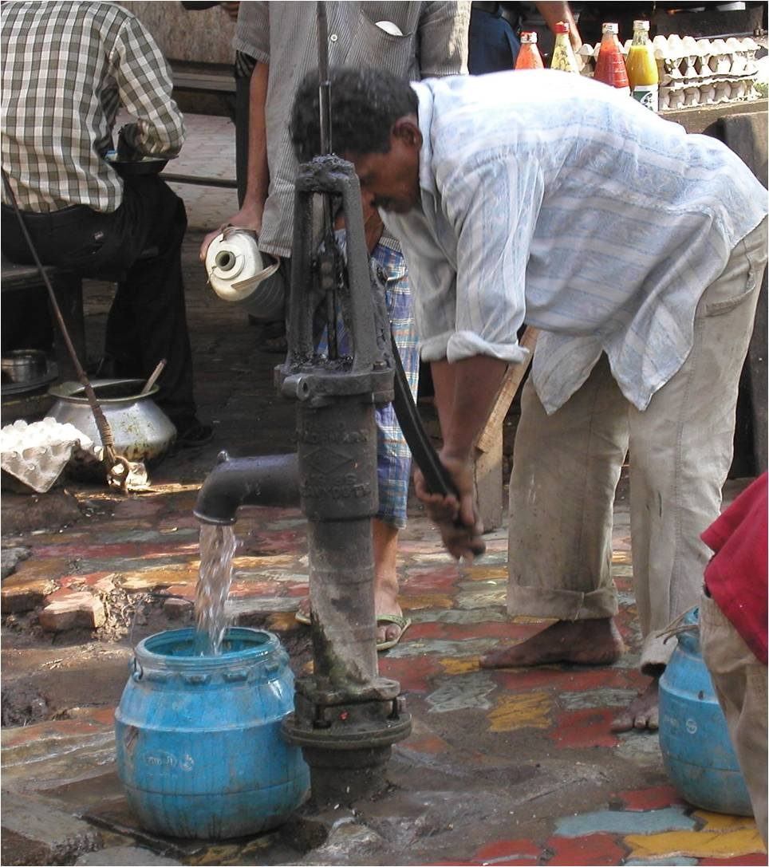
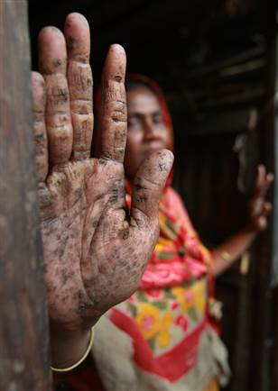

Slide 24
Hydrogeologists deal with 2 primary issues: Water Supply Water Quality Supply: - How much water can we extract? (sustainably?) - Where should we pump from to extract the most with the least impact? - How can we increase the amount of groundwater that we can pump (i.e., artificial recharge)? Quality: - How much and where should we pump in order to ensure good water quality? - Contaminant transport: if there’s a spill, where is it going? How can we clean it up (remediation)?

Slide 25
Hydrogeologists deal with 2 primary issues: Water Supply Water Quality Supply: - How much water can we extract? (sustainably?) - Where should we pump from to extract the most with the least impact? - How can we increase the amount of groundwater that we can pump (i.e., artificial recharge)? Quality: - How much and where should we pump in order to ensure good water quality? - Contaminant transport: if there’s a spill, where is it going? How can we clean it up (remediation)? Other issues: - engineering: dams, levees, basements!

Slide 26
Dam failure

Slide 27
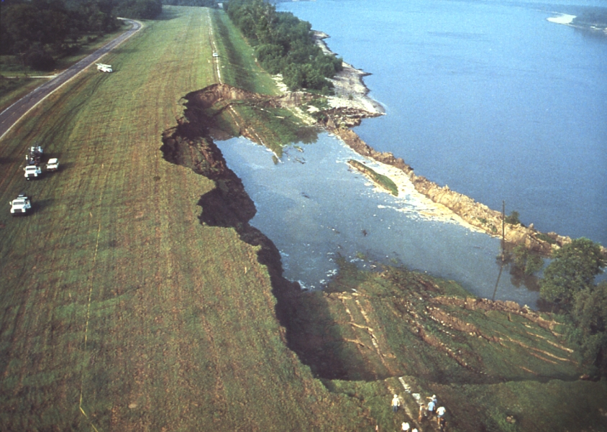
This 700 ft section of levee slid into the east side of the Mississippi River on August 23, 1983 at Darrow, in Ascension Parish, Louisiana. Groundwater flow processes likely contributed to this failure.
http://web.mst.edu/~rogersda/levees/

Slide 28
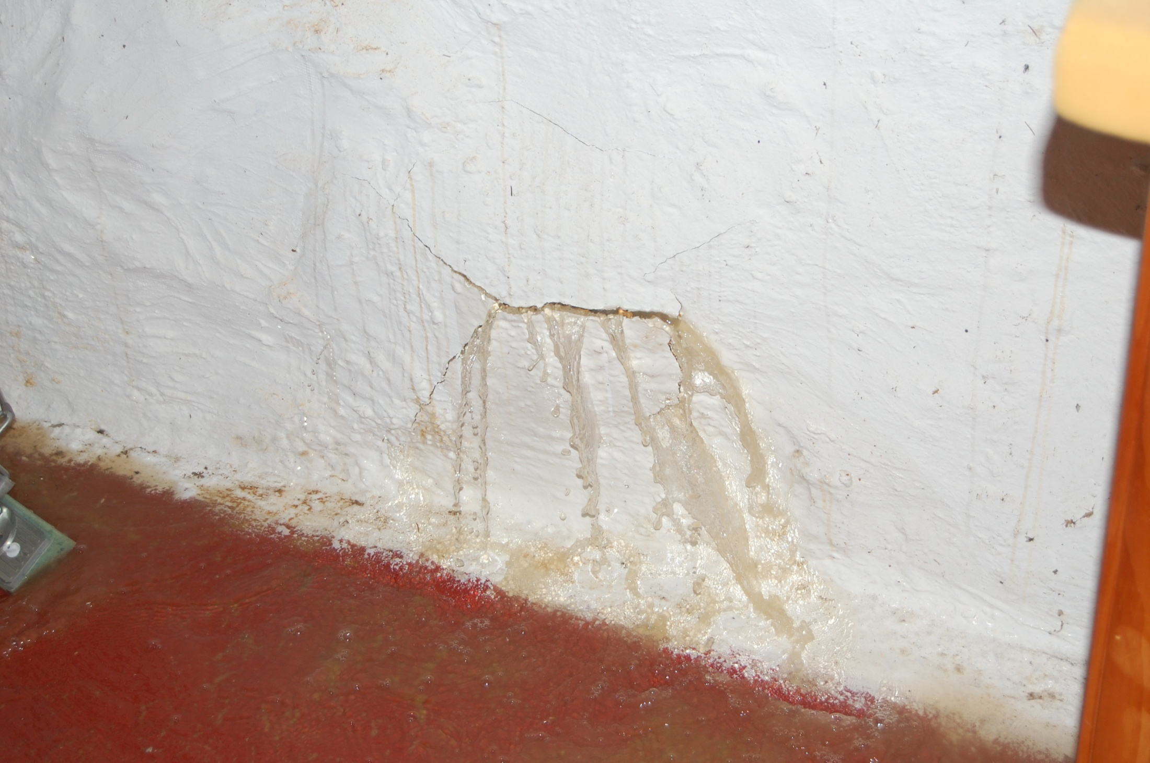
My Ph.D. Adviser’s basement

Slide 29
Hydrologic Cycle
List of reservoirs
List of pathways “Fluxes”

Slide 30
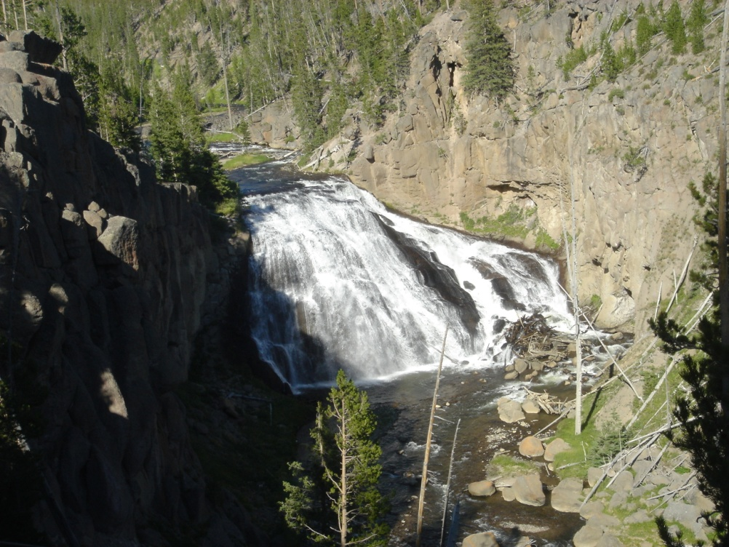
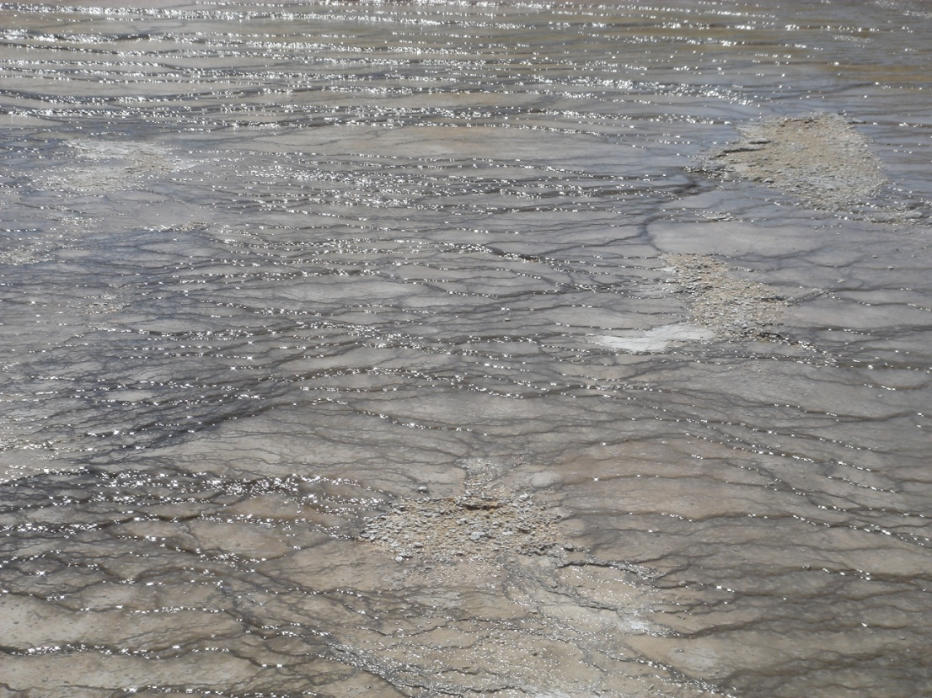
Some Definitions:
Runoff- That part of the precipitation that appears in surface streams. It is the same as streamflow

Slide 31
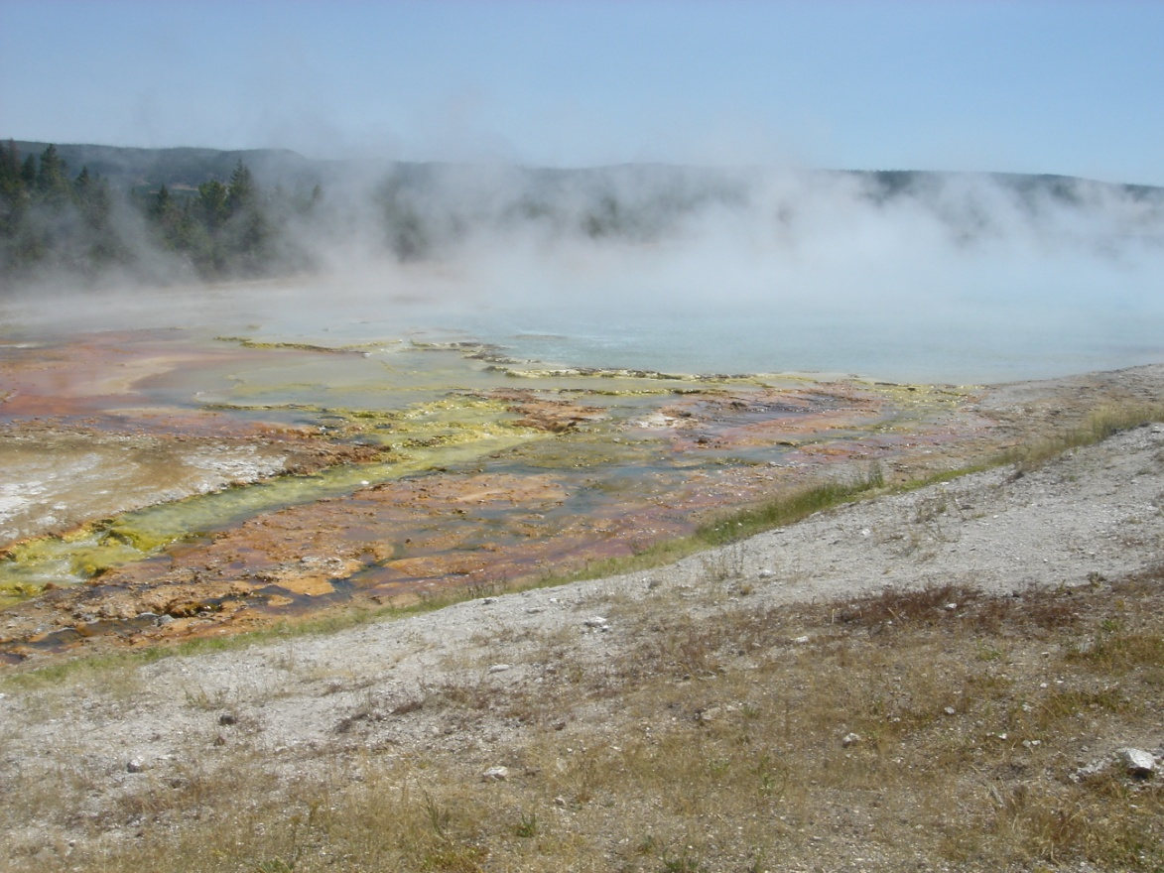
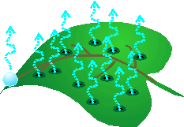
Some Definitions:
Precipitation- All water that falls from the atmosphere
Evapotranspiration (ET)- A collective term -> includes evaporation, transpiration, and sublimation.
Of precipitation on the continents, most (62%) is evapotranspired

Slide 32
Some Definitions:
Precipitation- All water that falls from the atmosphere to the earth’s surface.
Evapotranspiration (ET)- A collective term -> includes evaporation, transpiration, and sublimation.
Of precipitation on the continents, most (62%) is evapotranspired
Potential Evapotranspiration (PE)- Water loss that will occur if there is no deficiency of water (a function of the energy of the environment under maximum water conditions).

Slide 33
